Slide 1
Structural Patterns -I
Emre Kaplan, Ph.D.

Slide 2
Structural Patterns
Structural patterns are concerned with how classes and objects are composed to form larger structures.
Structural class patterns use inheritance to compose interfaces or implementations.
Structural object patterns describe ways to compose objects to realize new functionality.
The added flexibility of object composition comes from the ability to change the composition at run-time, which is impossible with static class composition.
Source: Freeman, E., Robson, E., Sierra, K., & Bates, B. (2004). Head First design patterns. Sebastopol, CA: O'Reilly.
Source: Erich Gamma, Richard Helm, Ralph Johnson, and John Vlissides. 1995. Design Patterns: Elements of Reusable Object-Oriented Software. Addison-Wesley Longman Publishing Co., Inc., Boston, MA, USA.

Slide 3
Structural Patterns
Structural Patterns
Adapter
Façade
Decorator
Proxy
Composite
Bridge
Flyweight

Slide 4
Adapter
Intent
Convert the interface of a class into another interface clients expect. Adapter lets classes work together that couldn't otherwise because of incompatible interfaces.
Client
Subject

Slide 5
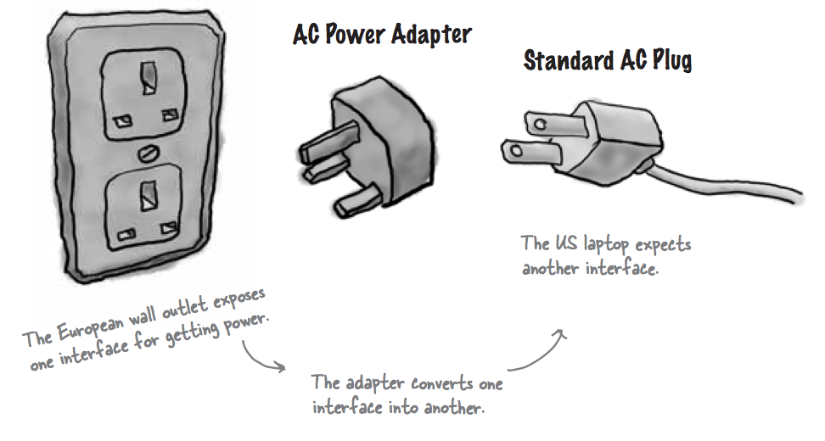
Adapter

Slide 6
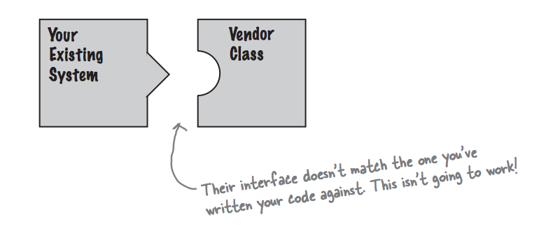
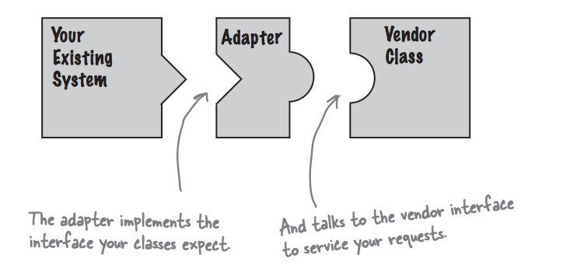
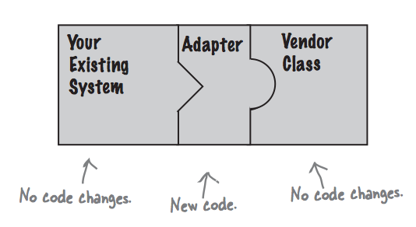
Adapter

Slide 7
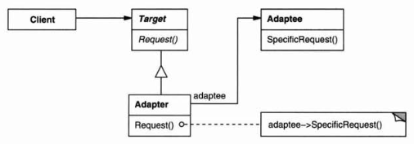
Structure
Object Adapter

Slide 8
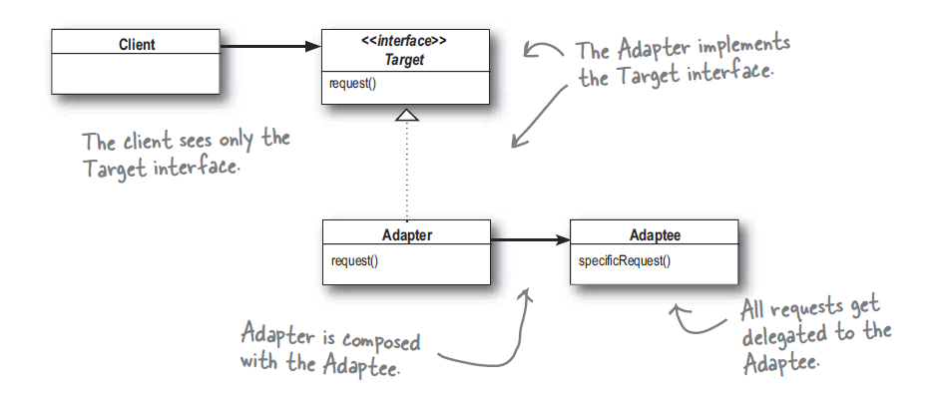
Adapter

Slide 9
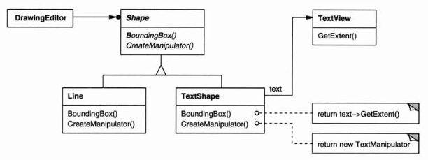
Adapter
Target (Shape)
defines the domain-specific interface that Client uses.
Client (DrawingEditor)
collaborates with objects conforming to the Target interface.
Adaptee (TextView)
defines an existing interface that needs adapting.
Adapter (TextShape)
adapts the interface of Adaptee to the Target interface.
Third party library class.

Slide 10
Adapter Applicability
Use the Adapter pattern when
you want to use an existing class, and its interface does not match the one you need.
you want to create a reusable class that cooperates with unrelated or unforeseen classes, that is, classes that don't necessarily have compatible interfaces.
Notes:
(object adapter only) you need to use several existing subclasses, but it's impractical to adapt their interface by subclassing every one. An object adapter can adapt the interface of its parent class.

Slide 11
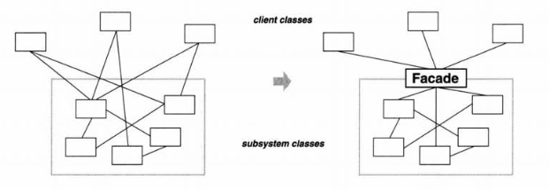
Façade
Intent
Provide a unified interface to a set of interfaces in a subsystem.
Define a higher-level interface that makes the subsystem easier to use.

Slide 12
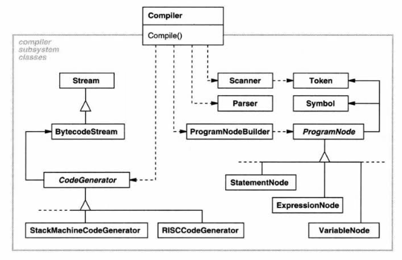
Façade
The compiler facade makes life easier for most programmers without hiding the lower-level functionality from the few that need it.

Slide 13
Implementation
class Compiler {
public:
Compiler();
virtual void Compile(istream&, BytecodeStream&);
};
void Compiler::Compile(istream& input, BytecodeStream& output) {
Scanner scanner(input);
ProgramNodeBuilder builder;
Parser parser;
parser.Parse(scanner, builder);
RISCCodeGenerator generator(output);
ProgramNode* parseTree = builder.GetRootNode();
parseTree->Traverse(generator);
}

Slide 14
Applicability
Use the Facade pattern when
you want to provide a simple interface to a complex subsystem. Only clients needing more customizability will need to look beyond the façade.
there are many dependencies between clients and the implementation classes of an abstraction. Introduce a facade to decouple the subsystem from clients and other subsystems
you want to layer your subsystems. Use a facade to define an entry point to each subsystem level. If subsystems are dependent, make them communicate with each other solely through their facades.

Slide 15
Collaborations
Clients communicate with the subsystem by sending requests to Facade, which forwards them to the appropriate subsystem object(s).
Although the subsystem objects perform the actual work, the facade may have to do work of its own to translate its interface to subsystem interfaces.
Clients that use the facade don't have to access its subsystem objects directly.

Slide 16
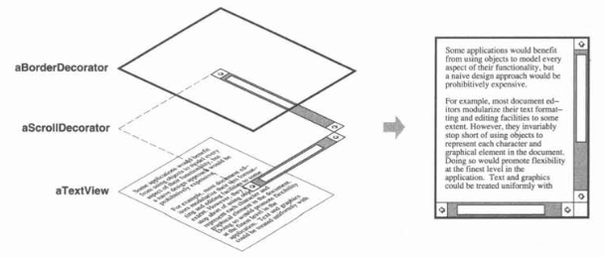
Decorator Pattern
Intent
Attach additional responsibilities to an object dynamically. Decorators provide a flexible alternative to sub classing for extending functionality.

Slide 17
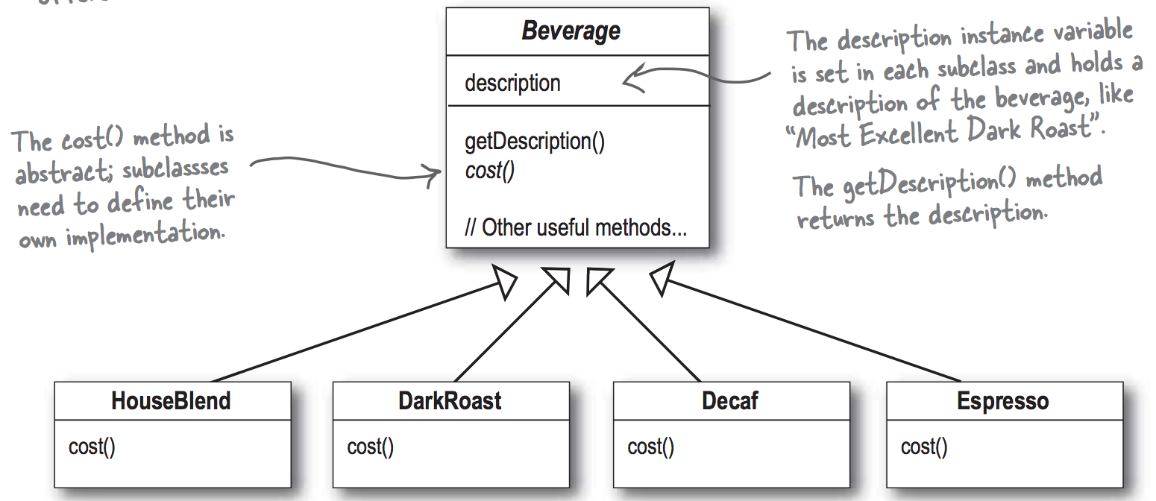
Starbuzz Coffee

Slide 18
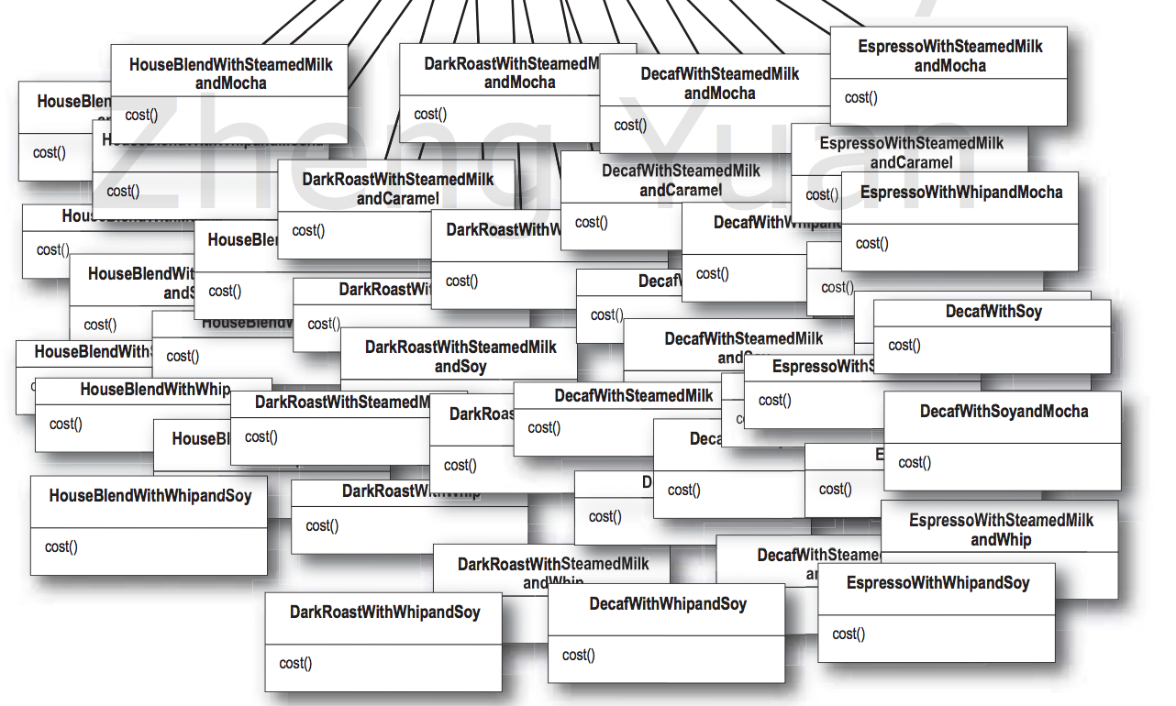
Condiments
Mocha, milk, sugar, cream, etc.

Slide 19
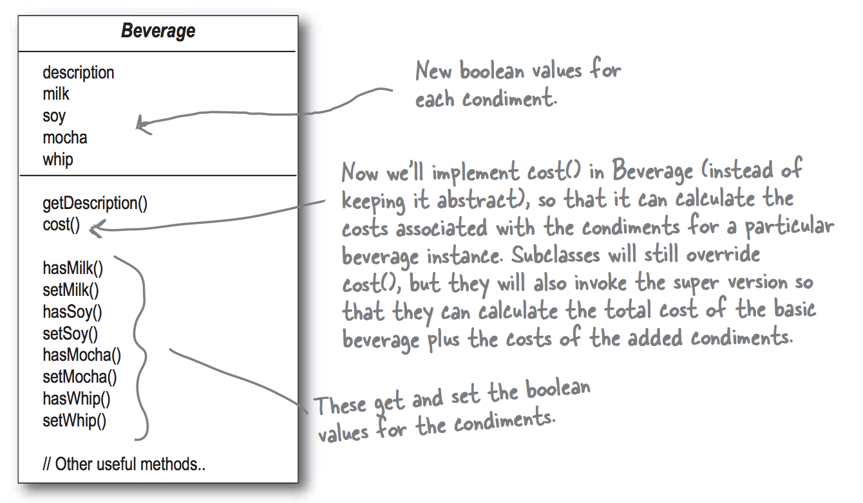
Decorator Pattern

Slide 20
Problems
New condiments will force us add new methods and change the cost() method
New beverages will inherit all the condiment method although some may not apply to them (iced tea and cream?)
What if somebody wants double mocha?

Slide 21
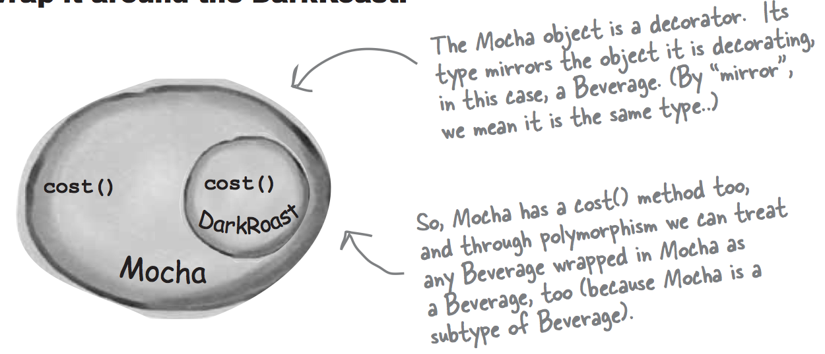
Decorator Pattern

Slide 22
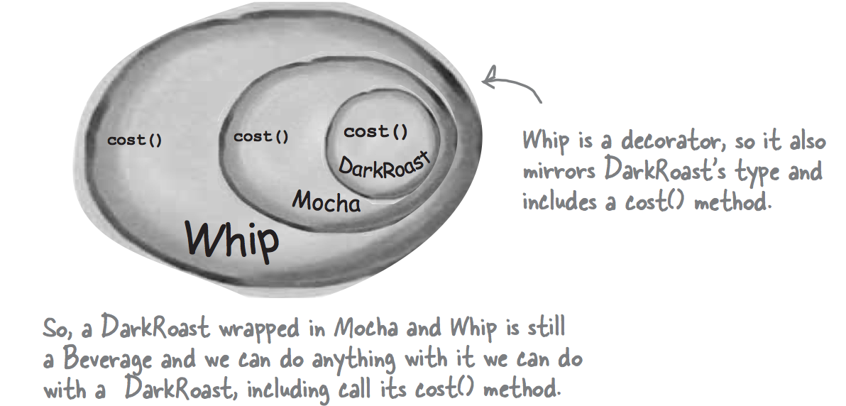
Decorator Pattern

Slide 23
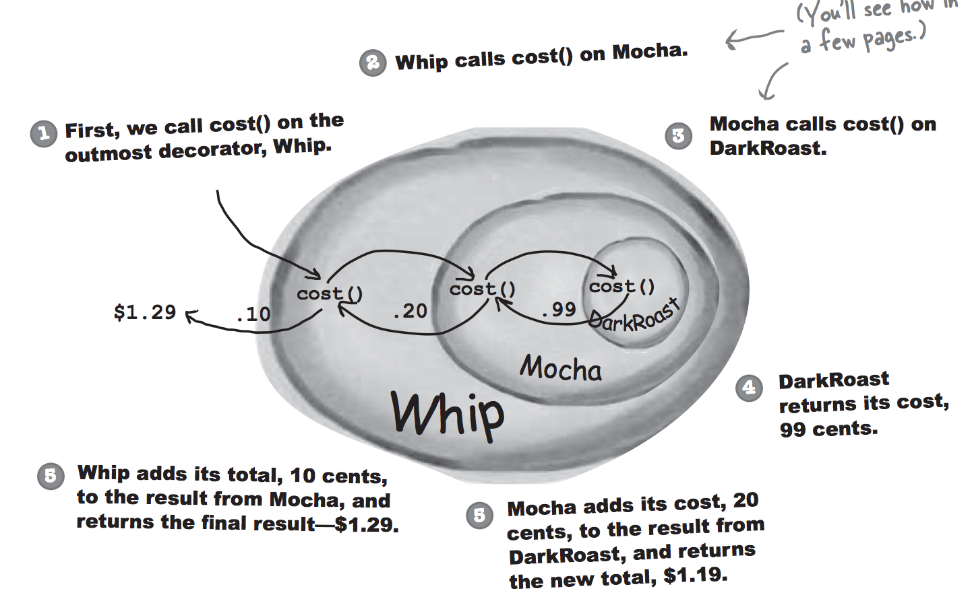
Decorator Pattern

Slide 24
Decorator Pattern
Add responsibilities to individual objects, not to an entire class.
Inheritance is inflexible, because the choice is made statically. A client can't control how and when to decorate the component.

Slide 25
Decorator Pattern
The decorator conforms to the interface of the component it decorates so that its presence is transparent to the component's clients.
The decorator forwards requests to the component and may perform additional actions (such as drawing a border) before or after forwarding.
Transparency lets you nest decorators recursively, thereby allowing an unlimited number of added responsibilities.

Slide 26
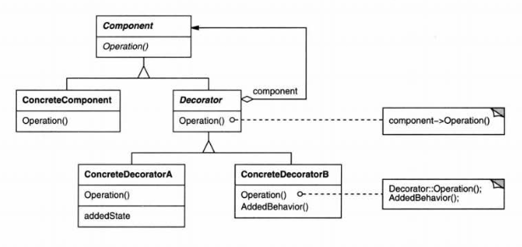
Structure

Slide 27
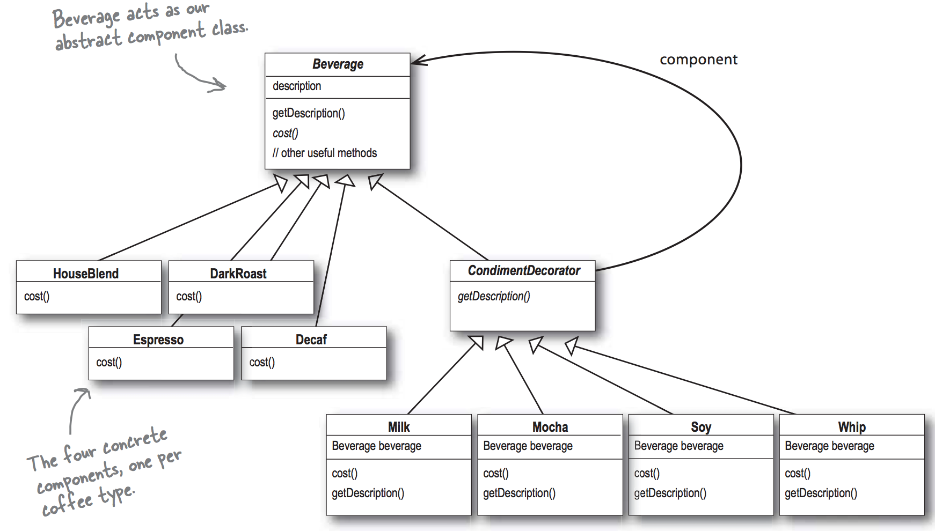
Decorator Pattern

Slide 28

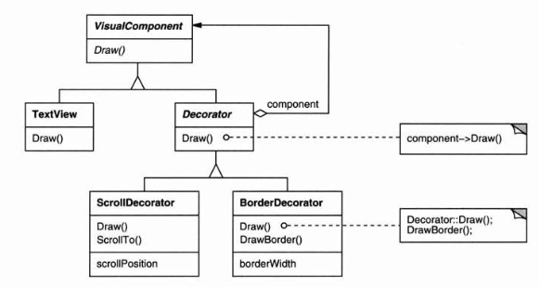
Decorator Pattern

Slide 29
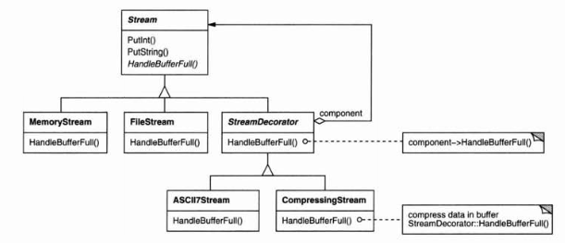
Another Example

Slide 30
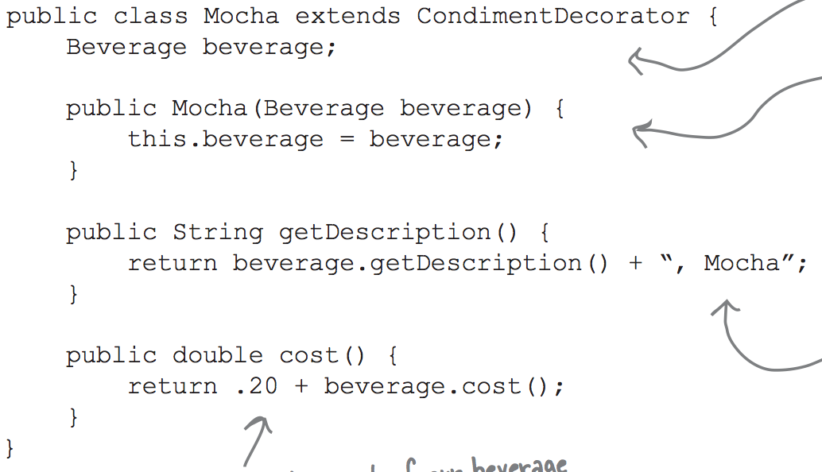
Decorator Pattern

Slide 31
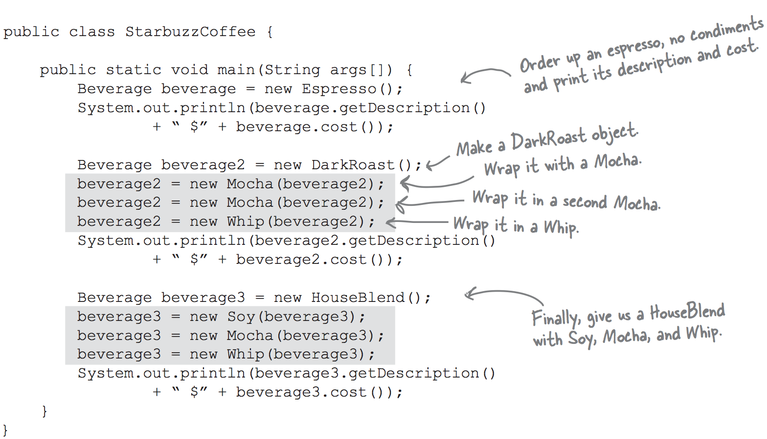
Decorator Pattern

Slide 32
Applicability
Use Decorator
to add responsibilities to individual objects dynamically and transparently, that is, without affecting other objects.
when extension by sub classing is impractical. (e.g.: an explosion of subclasses to support every combination.)

Slide 33
Liabilities
A decorator and its component aren't identical. You shouldn't rely on object identity when you use decorators.
Lots of little objects that differ only in the way they are interconnected, not in their class or in the value of their variables. Can be hard to learn and debug.

